Slide 1


NORCECA Refereeing Commission
One Size Does Not Fit All
The Role of a NORCECA Referee Coach
An Introduction
Guy Bradbury
May 3, 2022

Slide 2
NORCECA Refereeing Commission
In modern sport – to keep an edge everyone uses a coach - why not referees?
Do you know who or have you heard of these people?
Hank Heney –----------→ Coach for Tiger Woods
Paul Annacone –------ → Coach for Roger Federer
Derron Herah –--------→ Coach Elaine Thompson-Herah
Erin Virtue –------------→ Setter coach (USA Women’s VB National Team)
Even the best in world have coaches.

Slide 3
NORCECA Refereeing Commission
What is the purpose of a NORCECA Referee Coach?
To improve individual performance (Technically, Tactically, Mechanically, Psychologically and Mentally)
To enhance the experience of being a referee
To encourage and assist the referee to be the best they can be
To improve the service to the players and the game

Slide 4
NORCECA Refereeing Commission
As a Referee Coach – Points to Consider
It is important to know exactly who we are coaching, so that we adjust our approach and content accordingly.
Referees come with various degrees of experience; therefore, advice given, and the level of performance expected must meet the competition and the referee’s ability.
When coaching - the same core message must be delivered to all referees based upon FIVB Referee Pathway
The task of the referee is to support the match. Players manage the ball – referees make sure that the players decide the match

Slide 5
NORCECA Refereeing Commission
Difference between Mentor and Coach
It is important to appreciate the difference between a coach and a mentor:
  As a mentor, you may give advice to help a referee grow and develop
  As a coach, your task is to give the referee the space to find his/ her own solutions to problems experienced when managing a match and help them achieve their highest potential

Slide 6
NORCECA Refereeing Commission
Characteristics of a Volleyball Referee Coach
A leader – experienced at top level
Calming Influence
Listening/Good listener
Knowledgeable (Technically, and Mechanically in the application of the rules)
Respected
Probing/Questioning
Setting personal high standards

Slide 7
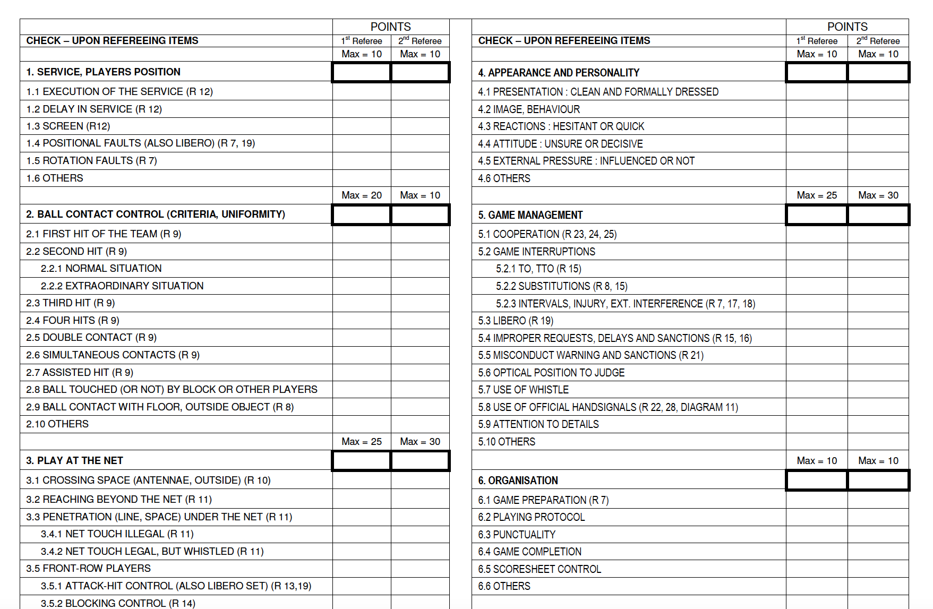
NORCECA Refereeing Commission
Where we have come from: Original FIVB Referee Evaluation Form

Slide 8
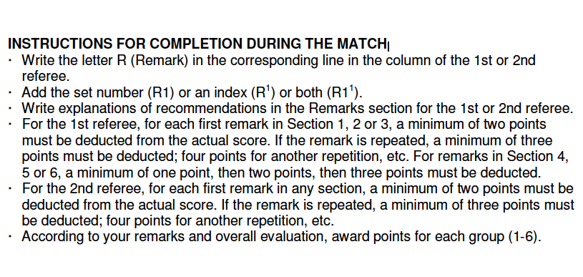
NORCECA Refereeing Commission
Where we have come from:
  The rater - Focus was on deducting points & no rewards for good decisions
  The referee – Stressful and some focus remained on past mistakes not on development

Slide 9
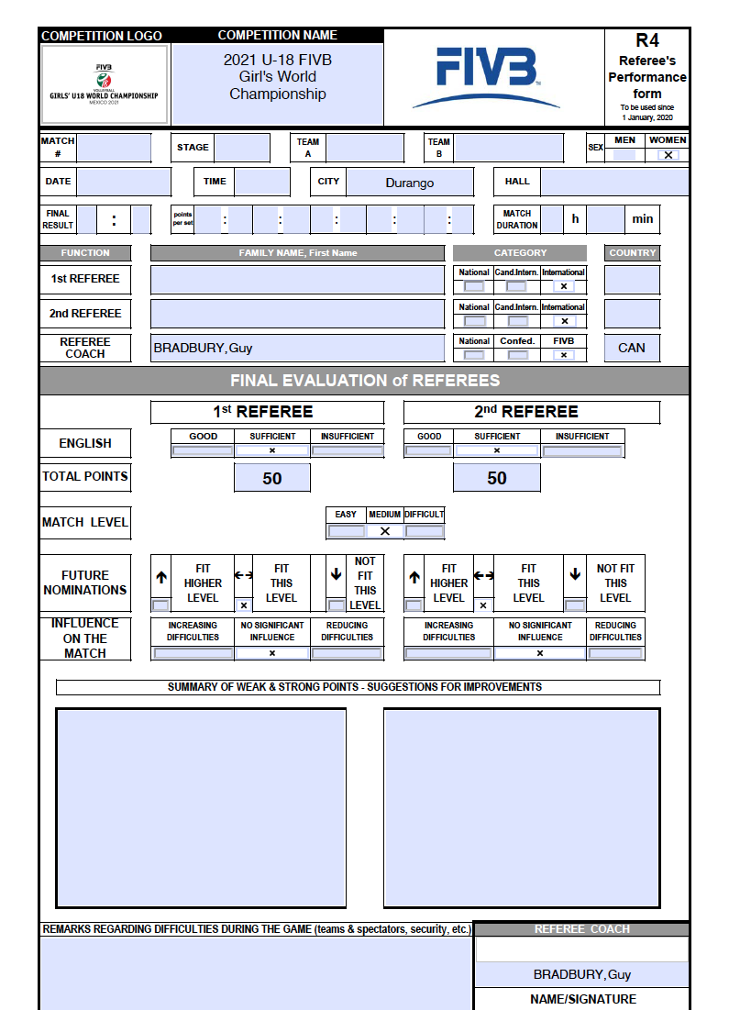
NORCECA Refereeing Commission
FIVB Referee Performance Form (R4)
2022

Slide 10
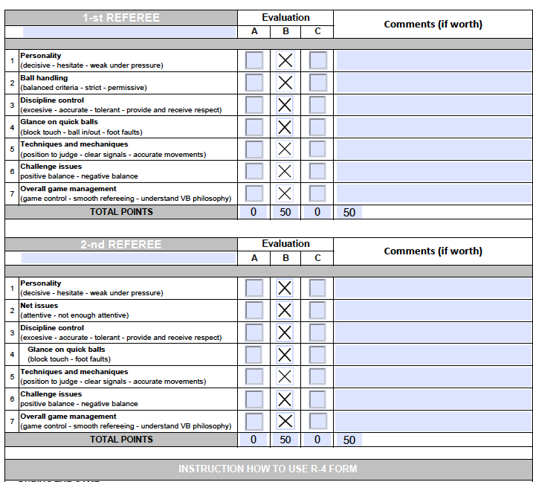
NORCECA Refereeing Commission
FIVB Referee Performance Form (R4)
2022

Slide 11
Evolution of Coaching – NORCECA
For Discussion
Adapted Coaching Model (Guy Bradbury - adapted from Hershey & Blanchard (1969))
Low Technical & Mechanical
High Coaching
Coaching
High
Advancing Referee
Q3
Category 3
Developing Referee
Q2
Category 4
High Technical & Mechanical
High Coaching
Coaching
Low
Low Technical & Mechanical
Low Coaching
Proficient Referee
Q4
Category 1-2
Beginning Referee
Q1
Category 5
High Technical & Mechanical
Low Coaching
Technical & Mechanical Low
Technical & Mechanical
High

Slide 12
NORCECA Refereeing Commission
Overview of Referee Coaching Quadrant
Referee Coaching is not a ‘one size fits all’ approach
Each referee’s personality is different
Each situation is different (even with a match)
As Referee Coaches we must understand the personality of a match

Slide 13
NORCECA Refereeing Commission
Overview of Referee Coaching Quadrants (it is not always about techniques and tactics)
Coaching: How Referee Coaches support referee in the mental, psychological and match management aspects of being a referee
Technical and Mechanical: Understanding the rules and the application of the rules. Understanding the nuance of using the whistle, signals and positioning, etc.

Slide 14
NORCECA Refereeing Commission
Referee Coaching – One Size Does Not Fit All
Adapted Coaching Model (Guy Bradbury - adapted from Hershey & Blanchard (1969))

Slide 15
NORCECA Refereeing Commission
Overview of Referee Coaching Quadrants
Quadrant 1 – Beginning
  This is defined as the referee beginning a new stage of their international refereeing career – Completed NORCECA Continental International Referee Course. (NORCECA Category 5)
Quadrant 2 – Developing
  This is defined as the referee who is on their refereeing journey and beginning to feel comfortable in their role as a referee.(NORCECA Category 4) The coaching at this stage is about building confidence and encouraging the referee in a collaborative fashion to continue with their growth

Slide 16
NORCECA Refereeing Commission
Overview of Referee Coaching Quadrants
Quadrant 3 – Advancing
  This is defined as the referee who has a good deal of experience and understanding of the technical and mechanical aspects of refereeing. The coaching at this stage is providing support for the mental, psychological and match management aspects of being a referee (NORCECA Category 3)
Quadrant 4 – Proficient
  This is defined as the referee who has a great deal of expertise, competency, and can whistle the highest level for their refereeing level. The coaching at this stage is about maintaining confidence, improvement, and providing supplementary advice to support referees for continuous growth and development (NORCECA Category 1-2)

Slide 17
NORCECA Refereeing Commission
Take Away Questions:
How well do you know yourself as a Referee Coach?
What do you think of your Referee Coaching toolkit?
What is in your Referee Coaching repertoire?
What is your dashboard?
  What do you do very well?
  What do you do well?
  What do you moderately do?
  What do you need to improve?
  What is your weakest coaching skill?

Slide 18
NORCECA Refereeing Commission
Referees Aspire to Improve, Therefore
Coach the Person First Then the Referee
(adapted from Dan Wright UFEA “A” Licensed Coach)
Thank You
Acknowledgement: I would like to thank Mr. Sandy Steele – FIVB Rules of the Game and Referee Commission for his support in the preparation of this presentation

Slide 19
NORCECA Refereeing Commission

Slide 20
NORCECA Refereeing Commission

Slide 21
NORCECA Refereeing Commission

Slide 22
NORCECA Refereeing Commission

Slide 23
NORCECA Refereeing Commission

Slide 24
NORCECA Refereeing Commission
Referee Coaching Quadrant Overview
Quadrant 1 – Beginning
  This is defined as the referee beginning a new stage of the their refereeing career – i.e.. Level 1 first competition or Level 4 attending their first USport/CCAA National Championship The coaching at this stage is more supporting the technical and mechanics, referee coaching provide direction
Quadrant 2 – Developing
  This is defined as the referee who on their refereeing journey and beginning to feel comfortable in their role as a referee. The coaching at this stage is about building confidence and encouraging the referee in a collaborative fashion to continue with their growth

